Slide 1
Dropout: A Simple Way to Prevent Neural Networks from Overfitting
Srivastava N, Hinton G E, Krizhevsky A, et al. Dropout: a simple way to prevent neural networks from overfitting[J]. Journal of Machine Learning Research, 2014, 15(1): 1929-1958.
Authors:
Nitish Srivastava
Geoffrey Hinton
Alex Krizhevsky
Ilya Sutskever
Ruslan Salakhutdinov
Presented by:
Christoph Schmidl
4226887
c.schmidl@student.ru.nl
17.05.2018
Research Seminar Data Science

Slide 2
Outline
Authors
General Information
Summary
Review
Discussion

Slide 3

Authors
Nitish Srivastava
Publication years: 2012 - 2015
Publication count: 7
Citation count: 521
Master’s Thesis: “Improving Neural Networks with Dropout”, University of Toronto, January 2013
Received his PhD in 2017 under supervision of Geoffrey Hinton and Ruslan Salakhutdinov: “Deep Learning Models for Unsupervised and Transfer Learning”
Other publications are related to Deep Boltzmann Machines

Slide 4
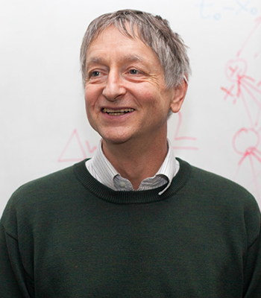
Authors
Geoffrey Everest Hinton
Publication years: 1983 - 2017
Publication count: 168
Citation count: 7380
The “Godfather of Deep Learning”
Co-invented Boltzmann machines
Works for Google and the University of Toronto
Famous for his image-recognition milestone in Imagenet challenge 2012 and his work on Artificial Neural Networks in general
“Geoffrey Hinton spent 30 years on an idea many other scientists dismissed”

Slide 5
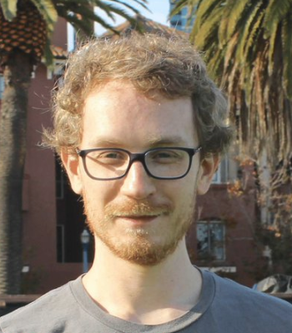
Authors
Alex Krizhevsky
Publication years: 2011 - 2017
Publication count: 4
Citation count: 1625
Invented “AlexNet” with Geoffrey Hinton and Ilya Sutskever
“AlexNet” contained 8 layers: 5 convolutional and 3 fully connected layers
Co-Author of the paper “ImageNet Classification with Deep Convolutional Neural Networks”, 2012
Relies on Dropout

Slide 6

Authors
Ilya Sutskever
Publication years: 2008 - 2017
Publication count: 24
Citation count: 2469
Co-founder and Research Director of OpenAI
Research Scientist at the Google Brain Team
Co-founder of DNNresearch
Postdoc in Stanford with Andrew Ng’s group

Slide 7
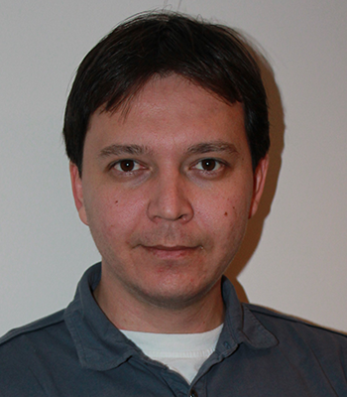
Authors
Ruslan Salakhutdinov
Publication years: 2002 - 2016
Publication count: 67
Citation count: 2114
Associate Professor of Computer Science at the Carnegie Mellon University
Director of AI Research at Apple

Slide 8
General Information
Written in 2012
Submitted to the Journal of Machine Learning Research in 2013
Published in 2014
388 citations in total
Between 2014 and 2018 (still relevant)
36 references
Yann LeCun, Director of AI Research at Facebook
Ian Goodfellow, Staff Research Scientist at Google Brain
Inventor of Generative Adversarial Networks

Slide 9
Summary
Introducing a method to prevent overfitting by randomly dropping units along with their connections
Major improvements over other regularization methods
Stop training on certain criteria
Weight penalties like L1 and L2 regularization
Applied to supervised learning tasks
Vision (MNIST, CIFAR-10, CIFAR-100, SVHN, ImageNet)
Speech Recognition (TIMIT)
Document Classification (Reuters-RCV1)
Computational Biology (Alternative Splicing Data set)

Slide 10
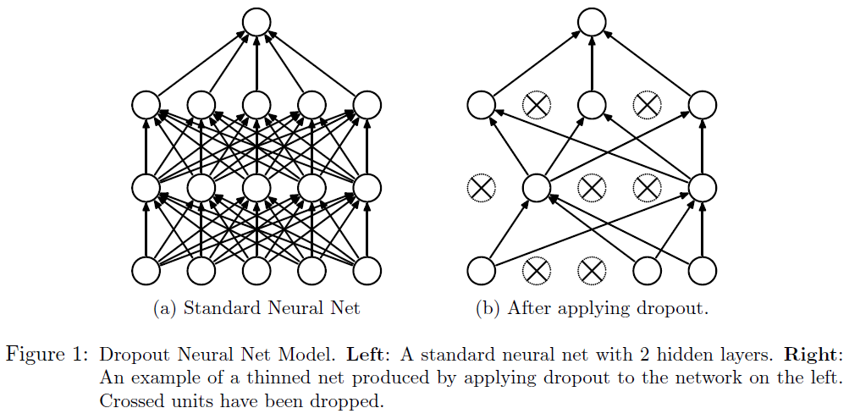
Summary - Key Idea
Drop units along with their connections by a certain probability
Prevent heavy co-adaptations
Provides a way of approximately combining exponentially many different neural network architectures: “thinned networks”

Slide 11
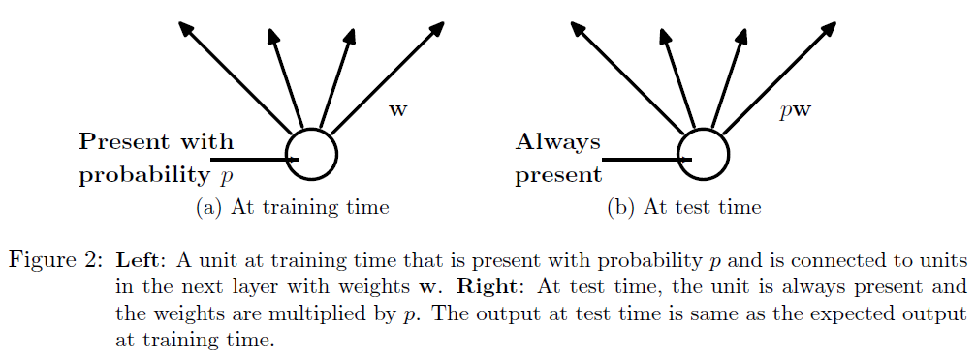
Summary - Key Idea
p = probability to retain a unit
Training a network with dropout = Training a collection of 2^n thinned networks with extensive weight sharing
Testing a network with dropout = Simple approximate averaging method using one network

Slide 12
Summary - Learning Dropout Nets
Dropout Neural Networks can be training using SGD
For each training case in a mini-batch, a thinned network is sampled
Forward and backpropagation are solely done on this thinned network
Max-norm regularization especially useful for dropout
Constraining the norm of incoming weight vector to constant c
Dropout can be used to finetune nets that have been pre-trained by
Restricted Boltzmann Machines
Deep Boltzmann Machines
Autoencoders

Slide 13
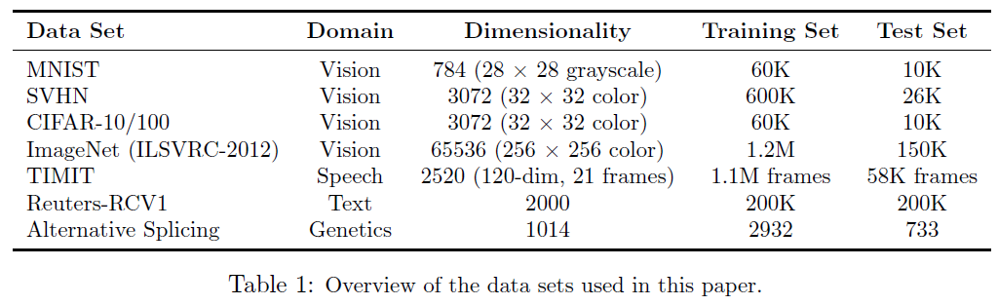
Summary - Used Datasets

Slide 14
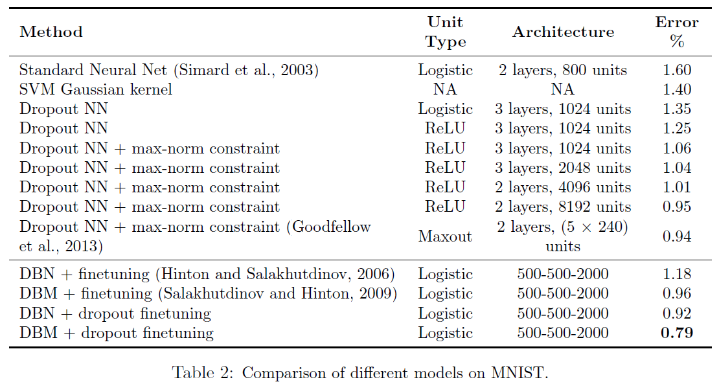
Summary - MNIST Results

Slide 15
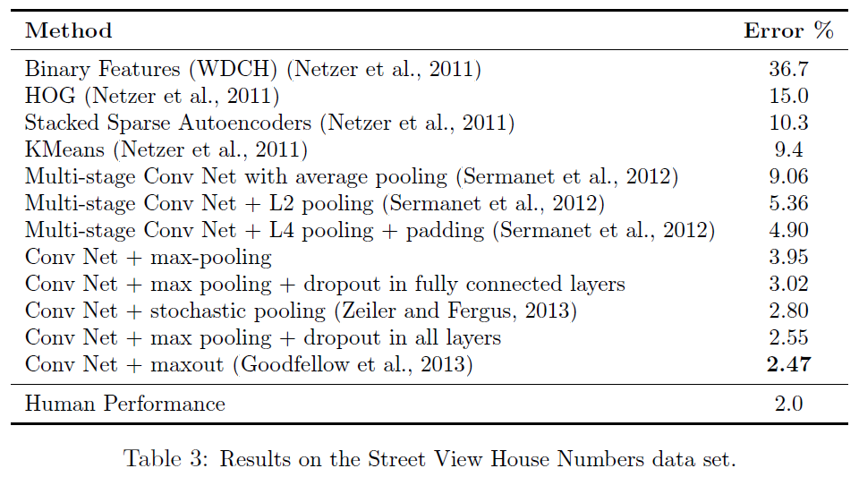
Summary - Street View House Numbers Results
A maxout layer is simply a layer where the activation function is the max of the inputs

Slide 16
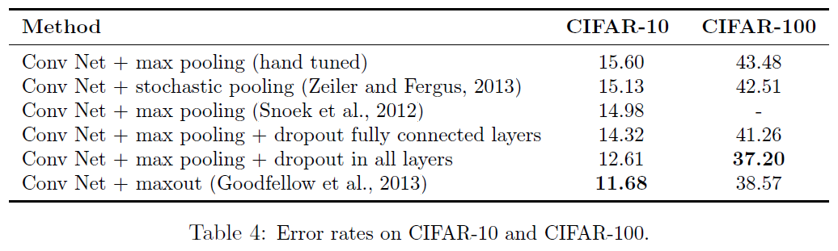
Summary - CIFAR-10 and CIFAR-100 Results

Slide 17
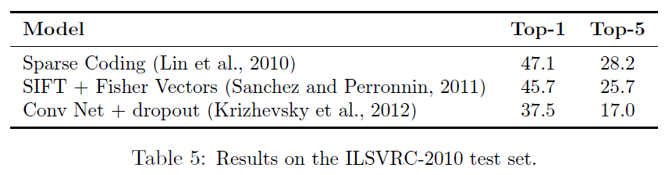
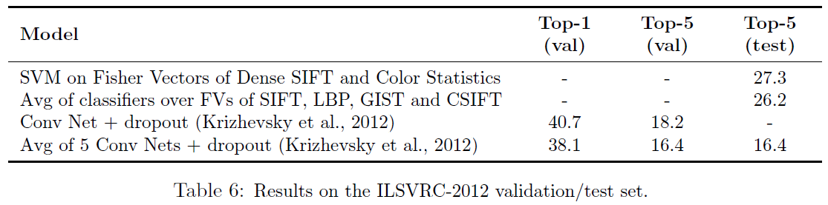
Summary - ImageNet Results

Slide 18
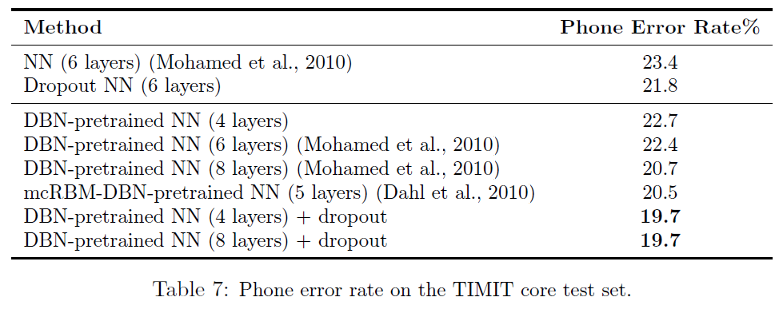
Summary - TIMIT Results

Slide 19
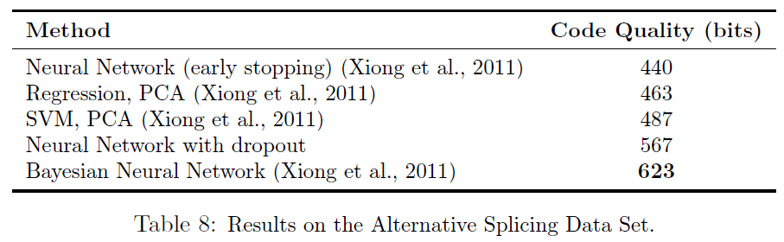
Summary - Alternative Splicing Data Set Results
Comparison with Bayesian Neural Networks
Bayesian Neural Networks perform better

Slide 20
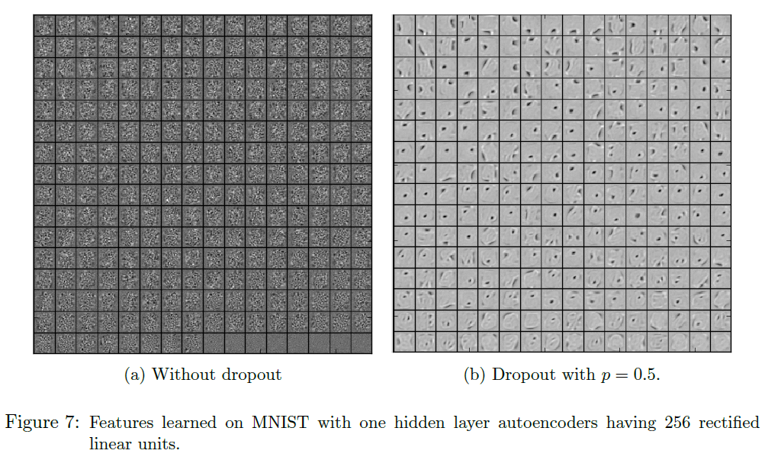
Summary - Dropout Effects

Slide 21
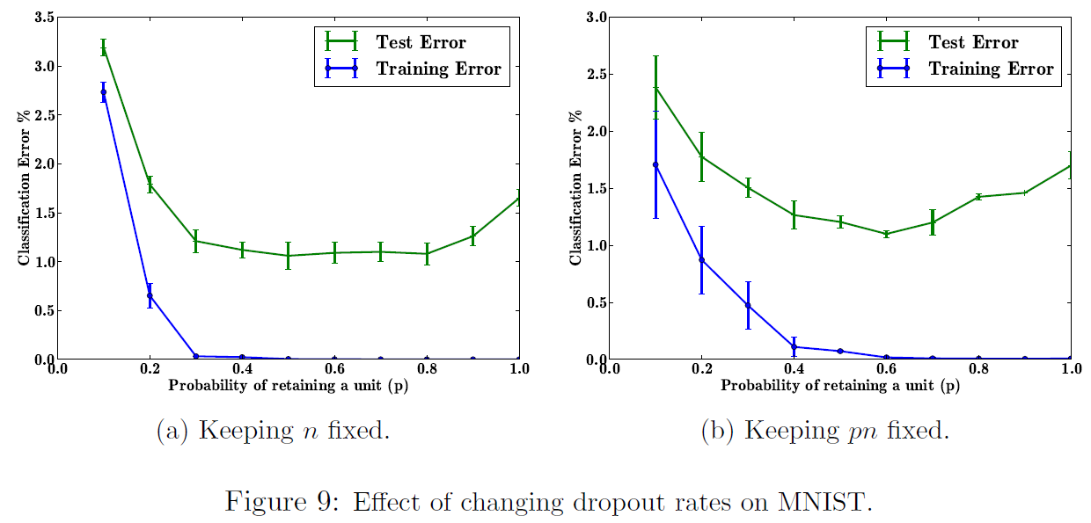
Summary - Dropout Effects

Slide 22
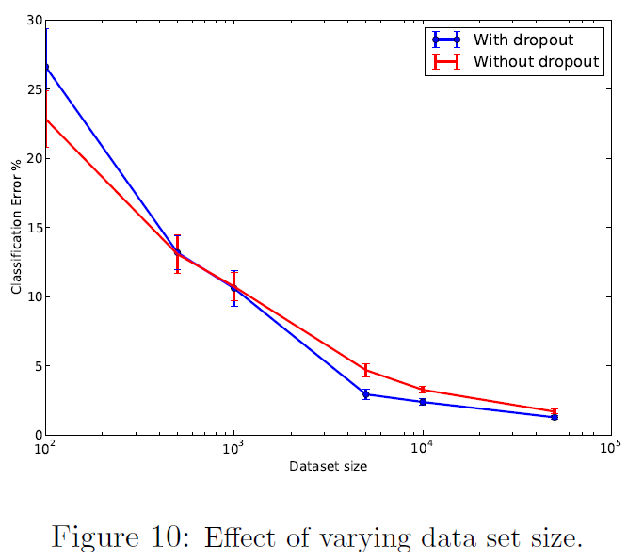
Summary - Dropout Effects

Slide 23
Review
Well written
Simple but yet effective idea
Experiments have been chosen to cover different domains
Practical Guide in Appendix
Contributed to the more famous paper “ImageNet Classification with Deep Convolutional Neural Networks”

Slide 24
Discussion
How do you think Dropout compares to other techniques to prevent overfitting, like L2 regularization and Batch Normalization?
When should Dropout be used over other techniques?
Should we always use Dropout?
Do you think the length of the paper was necessary to make a compelling case for the intrusive regularization method?
It appears that Dropout is not used anymore in a number of large available networks such as Resnet, InceptionV3. Why do you think they do not use Dropout?

Slide 25
Discussion
Given the paper “Understanding Deep Learning Requires Rethinking Generalization” from the last session, do you think that dropout actually prevents overfitting or might there be another reason why the generalization error is decreased?
Newer articles hardly ever mention dropout anymore. Many deep supervised models are nowadays done with residual convolutional architectures that make use of batch normalization. Has dropout become redundant?
Since the authors note that removing any convolutional layer resulted in inferior performance, can we expect better performance if we add even more convolutional layers?

Slide 26
Discussion
A hyper parameter p with a high value can be interpreted as resulting in too complex co-adaptations between neurons. What could be an interpretation of a higher error associated with a low p value?
The authors mention a speedup of Dropout is an interesting direction for future work. Have people tried improving Dropout and how much did it improve?
The authors mention that the gradients that are being computed are not gradients of the final architecture. This increases training time as the network is effectively training a different network every time. Do you think there's a solution for this limitation? Perhaps there's some sort of technique for optimizing these gradient updates such that the training time decreases.

Slide 27
Discussion
The authors mention that multiplicative Gaussian noise led to equal or better performance when the mean and variance matched a Bernoulli distribution. However, they do not provide any explanation for this finding. Do you have an idea of why this might be better?

